Slide 1
FIFA World Cup 2022 Simulation
David Henry Ibezim

Slide 2
Table Of Contents
Introduction
Background
Design
Results
Conclusion

Slide 3
Introduction

Slide 4

About Me
Role:
Data Engineer
Tech Interests:
Cloud Computing & Cybersecurity
Machine Learning & Data Visualization
Fun Fact:
A die-hard football fan

Slide 5

Background
Globally recognized sporting event.
Occurs every 4 years since its inception from 1930
Contested by senior national football teams
Consists of a group stage and single elimination rounds

Slide 6
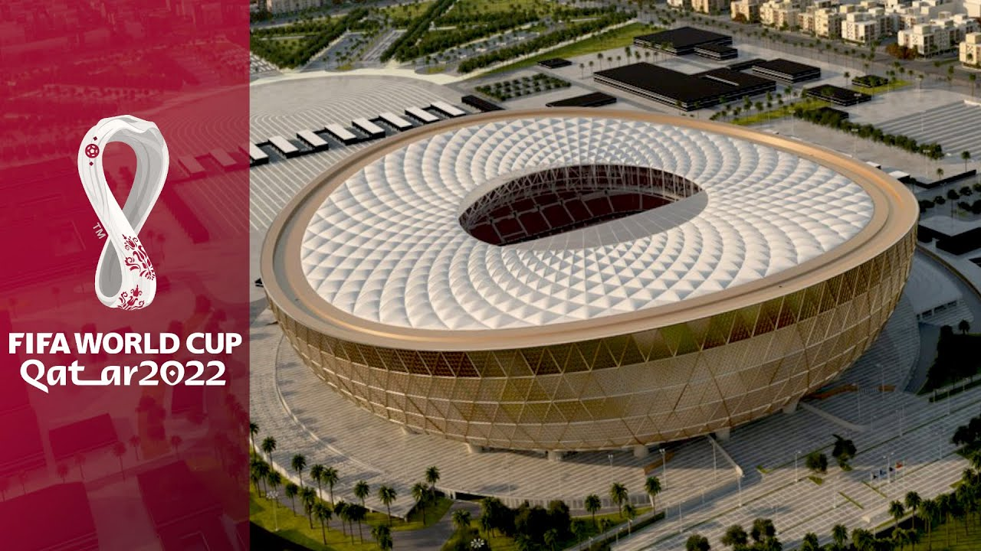
Business Impact
Estimated global betting volume of $30B
$5.3B projected for 2018, an 8% increase over 2014. Actual revenue was $5.36B
Identifying favorites and potential dark horse teams

Slide 7
Design

Slide 8
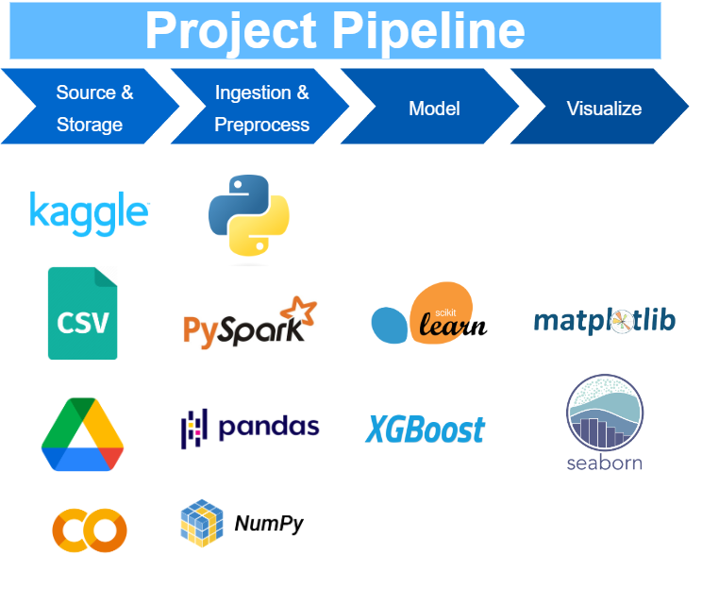

Slide 9


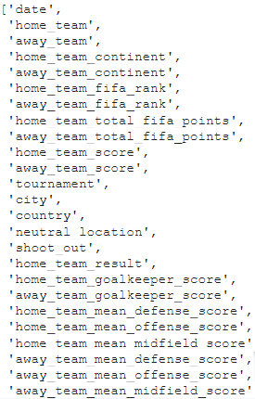
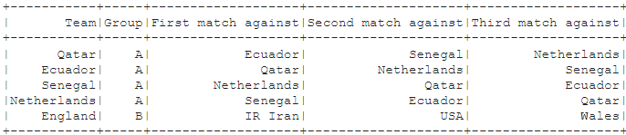
Exploratory Data Analysis

Slide 10
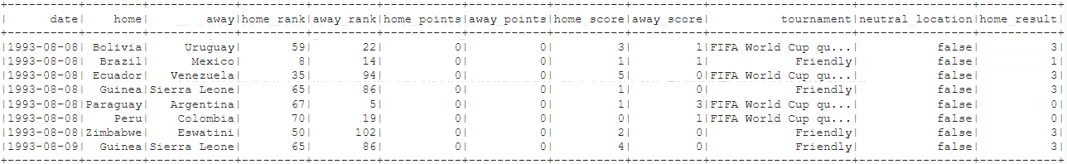
Exploratory Data Analysis
Created integer representation of categorical column “home_result” using pyspark sql
matchesp = matchesp.withColumn("home_result", F.when(F.col("home_result") == "Win", 3).when(F.col("home_result") == "Draw", 1).otherwise(0))
matchesp.show(8)

Slide 11
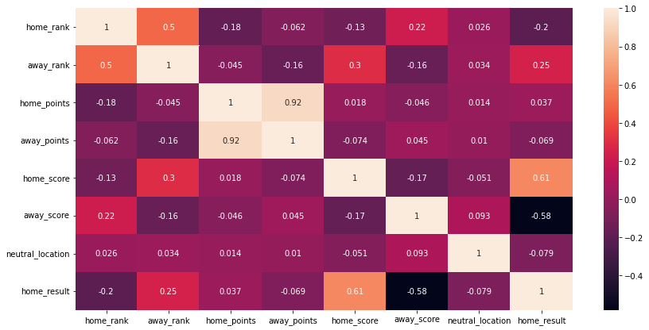
Exploratory Data Analysis
Correlation of international matches dataset

Slide 12
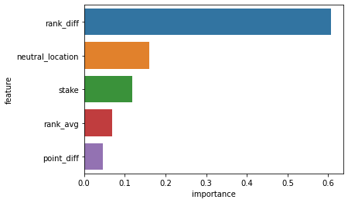
Features and Importance
+----------------+-------------------+
| feature| importance|
+----------------+-------------------+
| rank_diff| 0.605817437171936|
|neutral_location|0.16039200127124786|
| stake|0.11861906200647354|
| rank_avg|0.06842592358589172|
| point_diff|0.04674556851387024|
+----------------+-------------------+

Slide 13
Project Model
Using scikit-learn model selection, a split of 70/30 was used for the training and testing data.
XGBoost
Initial training score was 56%
Hyper-parameter tuning increased it to 58.54%
Random Forest
Initial training score was 50.48%
Hyper-parameter tuning increased it to 55.46%

Slide 14
Results

Slide 15
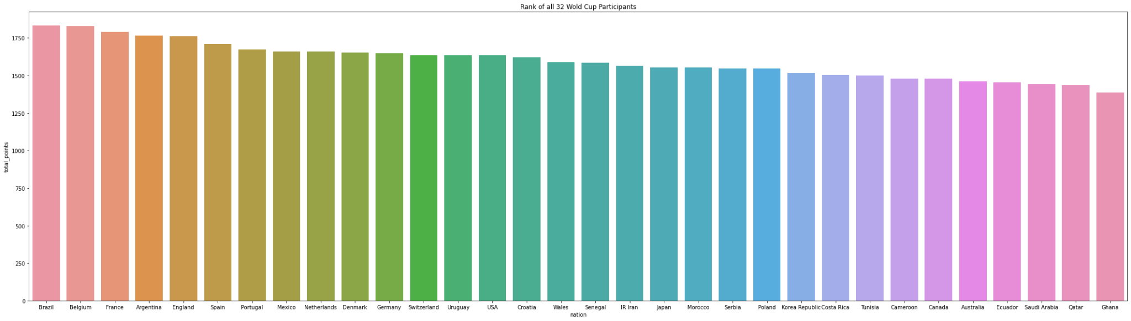
Participant Ranking
Number of participants = 32

Slide 16
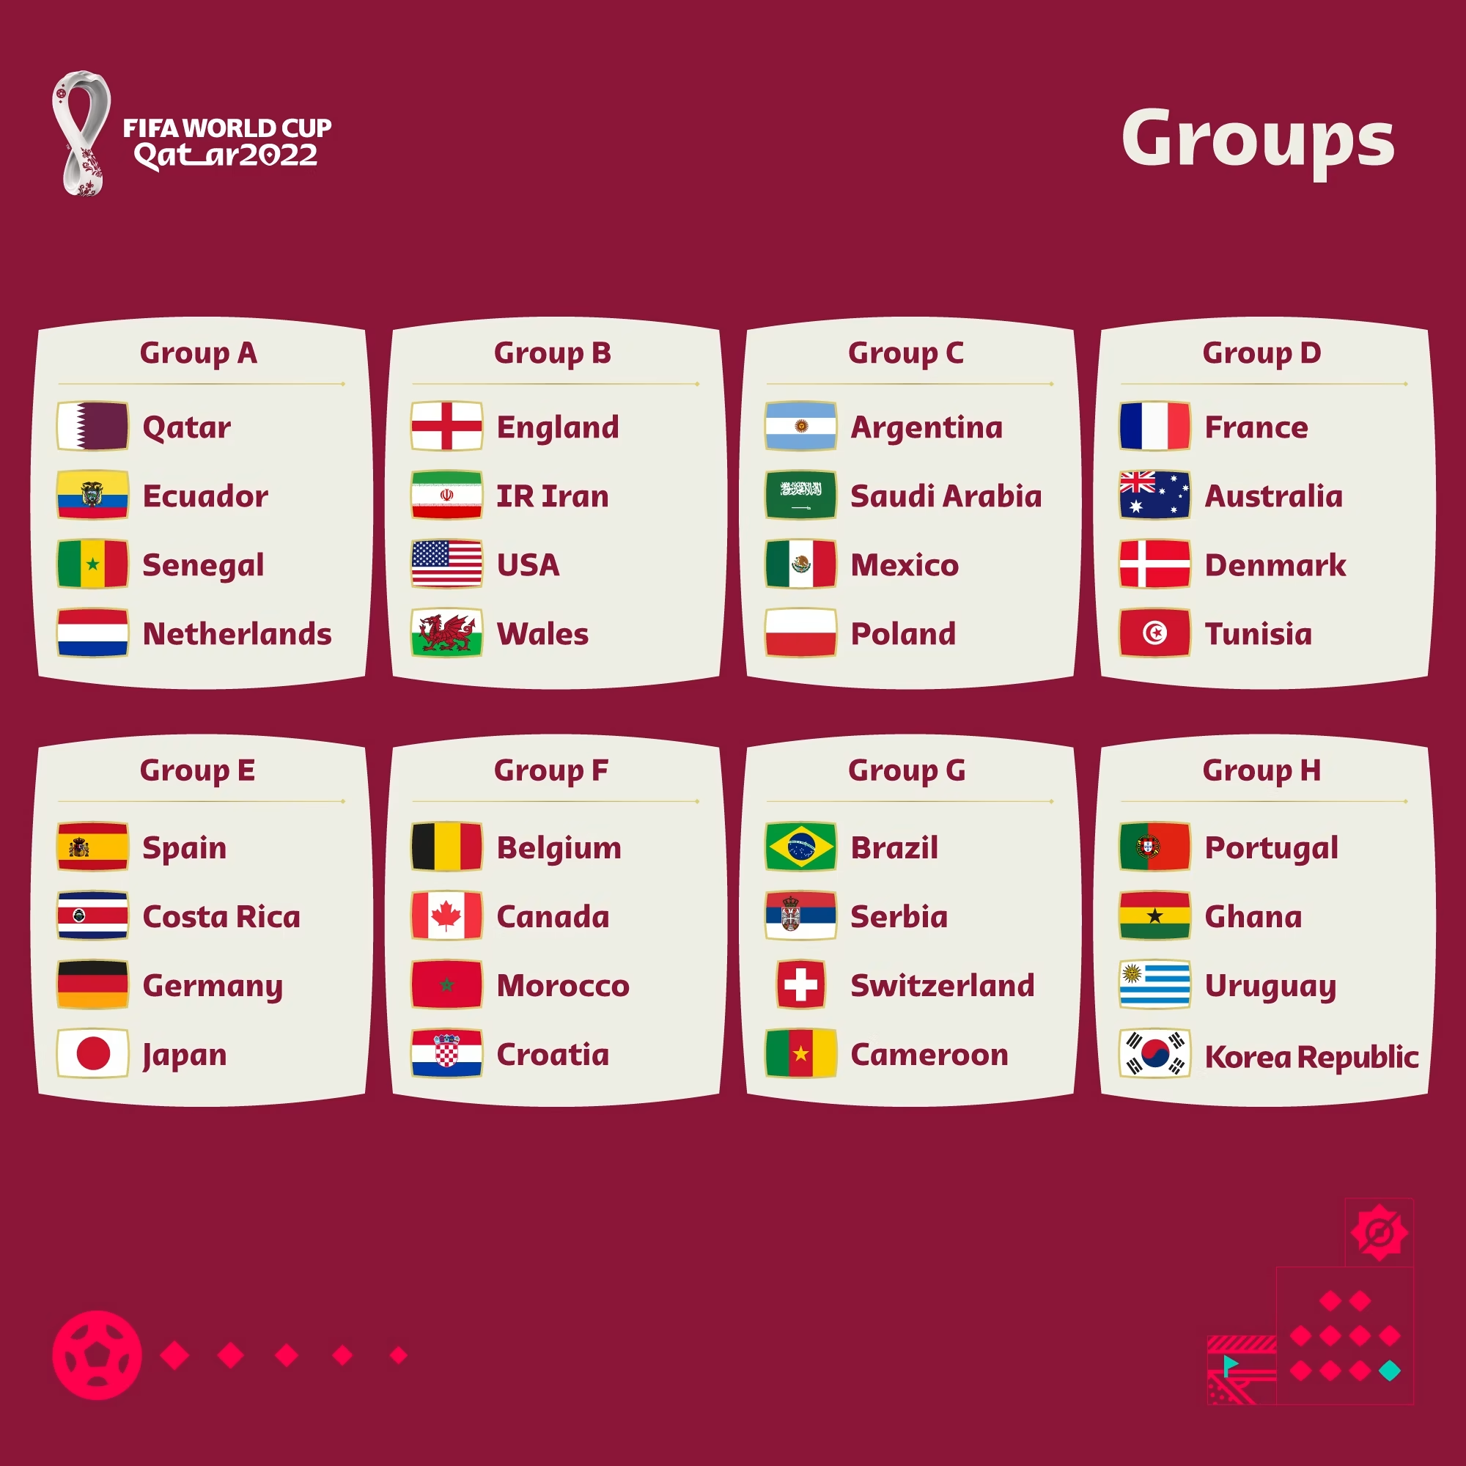
Group Stage Simulation
___Starting group H:___
Portugal vs. Ghana: Portugal wins with a probability of 0.69%
Portugal vs. Uruguay: Portugal wins with a probability of 0.45%
Portugal vs. Korea Republic: Portugal wins with a probability of 0.53%
Ghana vs. Uruguay: Uruguay wins with a probability of 0.59%
Ghana vs. Korea Republic: Korea Republic wins with a probability of 0.51%
Uruguay vs. Korea Republic: Uruguay wins with a probability of 0.53%

Slide 17
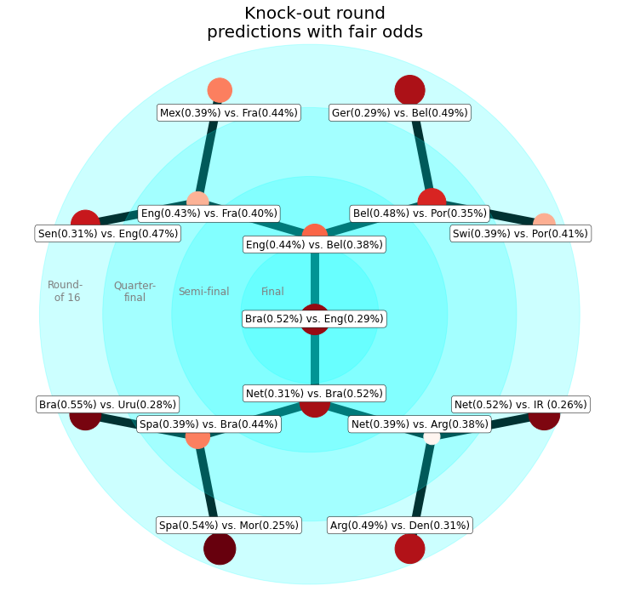
Knock-out Rounds Simulation

Slide 18
Conclusion

Slide 19
Conclusion
Future Research
Hyper-parameter tuning was computing intensive
Insight to what features drive the training of the model
Probability of a draw was very low
Exercising better data manipulation and refining the features
Incorporating Kafka into the pipeline to streamline live statistics
Predicting actual scores of a match simulation

Slide 20
Thank You

